Slide 1
EZ Stay Hotel
Griffin,Moriah, Jim

Slide 2
What works...
We were able to construct customer functionality
Used Visual Studio or Visual basic
Had issues reading from the database

Slide 3
What we couldn’t accomplish...
Spent all time on customer side didn’t have enough time to work on the employee side.
Here’s what was supposed to happen...

Slide 4
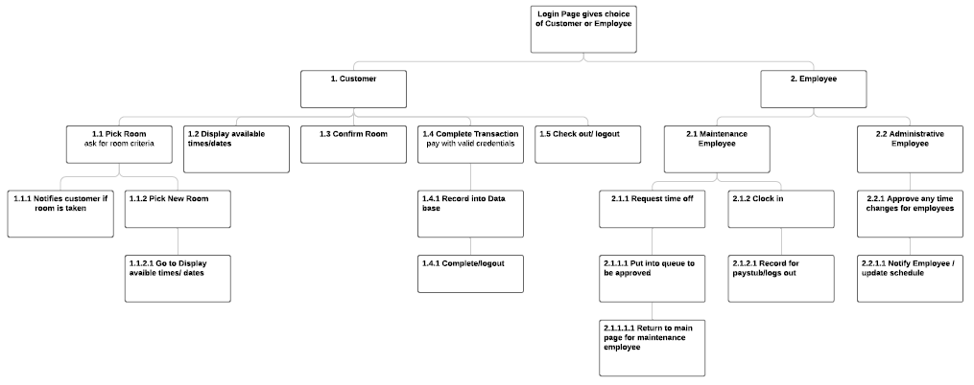
Original design...

Slide 5
Responsibility breakdown...
Griffin did most of the coding
Moriah was in charge of managing GitHub and making meetings and making sure everything was going smoothly
Both Moriah and Griffin conceptually drove the project
Notes:
Moriah: worked on check out and manage account

Slide 6
Meeting logistics...
We tried to meet as much as our schedules would allow it
We planned to meet regularly before each phase was due, to go over what could possibly change according to how much time we have and practice the presentation
Gradually we moved to conversing over texting and coordinating with google slides or docs, meeting less in person

Slide 7
Changing schedule and effect on team dynamics...
As the semester became busier we had less and less time to meet up and devote enough time to this project!
We tried to make an effort with working through shared documents online, such as github, however github gave us a lot of issues
Changing schedules definitely diminished team dynamics but as the final phase came, we came together to finish strong

Slide 8
Griffin’s experience and personal growth...
Despite the outcome I have gained experience with:
Writing requirement documentation
Creating system models prior to implementation
Proper scheduling and schedule making
GUI creation and design
Microsoft Access Databases and how to populate them with user input
Overall learned a lot about software engineering, from conceptualization to releasing the final product.

Slide 9
Moriah’s experience and personal growth...
This project helped me...
With managing time in a project
See that no matter how much planning might happen, schedules shift and you can’t always go according to plan
How important it is to understand concepts before trying to implement them, figuring out the logistics of the software was what consumed most of our time
Helped understand software engineering concepts

